Slide 1

DUNGEON BERSERKER by FRIED CUCUMBERS

Slide 2
Team project
Dungeon Berserk, is a roguelike dungeon cralwer
If you like Enter The Gungeon, you’ll like Dungeon Berserker.
Can be found here:
https://github.com/UbiBelETF/dagger/tree/team/fried_cucumber/main
Notes:
You should have a working knowledge
of basic object-oriented programming concepts and at least some experience
programming in C++.

Slide 3
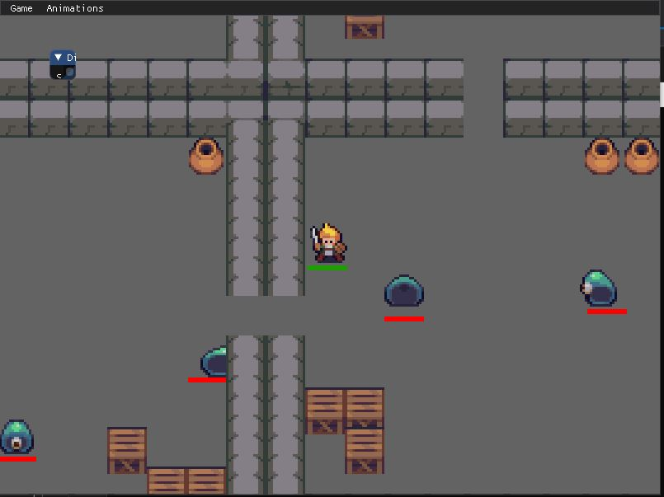
This is our herowith its health bar below him in the dungeon and his enemies. The boxes can also be destroyed so u can walk on them
Notes:
You should have a working knowledge
of basic object-oriented programming concepts and at least some experience
programming in C++.

Slide 4
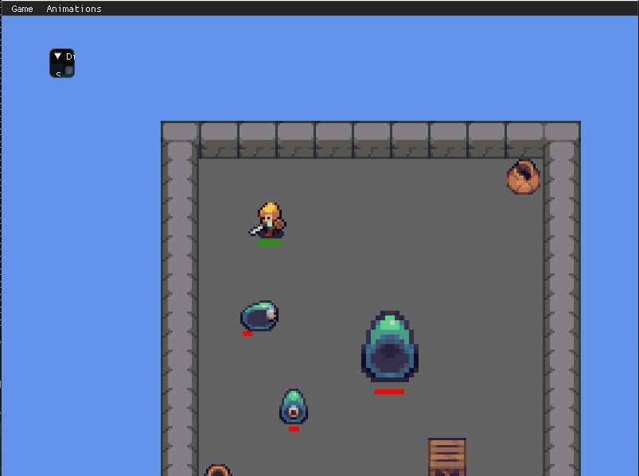
Here we can see the boss room and the boss (Big slime)

Slide 5
Team members
Stefan Bozovic
Nikola Ristic
Rastko Miocinovic
Notes:
You should have a working knowledge
of basic object-oriented programming concepts and at least some experience
programming in C++.

Slide 6
Game description
Player can walk around kill slimes and destroy boxes
The game is set in a dungeon full of slimes
Your goal is to kill the boss, big slime
Killing the boss is hard because u have to get past many small slimes which are on the way to the boss
Notes:
You should have a working knowledge
of basic object-oriented programming concepts and at least some experience
programming in C++.

Slide 7
Game features
You walk around using AWSD keys and attack with mouse1
Implemented by Stefan Bozovic
Notes:
You should have a working knowledge
of basic object-oriented programming concepts and at least some experience
programming in C++.

Slide 8
Game features
Small slimes that defend the boss patrol around and attack you when you get close to them
Implemented by Nikola Ristic
Notes:
You should have a working knowledge
of basic object-oriented programming concepts and at least some experience
programming in C++.

Slide 9
Game features
The main camera follows your main character
Implemented by Rastko Miocinovic
Notes:
You should have a working knowledge
of basic object-oriented programming concepts and at least some experience
programming in C++.

Slide 10
Game features
The main goal is to kill the big slime after which you’ve won the game. But if you u get killed by any of the slimes you lose and have to start over again
Implemented by Nikola Ristic
Notes:
You should have a working knowledge
of basic object-oriented programming concepts and at least some experience
programming in C++.

Slide 11
Game features
The game has a level editor which can be used to change the map layout and complexity
Implemented by Nikola Ristic
Notes:
You should have a working knowledge
of basic object-oriented programming concepts and at least some experience
programming in C++.

Slide 12
Nikola Ristic
Ping pong feature
Ball speed
Ping pong feature
Pause
Hero and slime animation
Tile system
Tile system
Simple Ai
Simple Ai
Level Gen
Attack, Health
Win, Lose
Stefan Bozovic
Learning Dagger engine
Character movement and animations
Character movement and animations
Character movement with FSM
Character attack with FSM and animations
Character attack with FSM and animations
Character combat
Rastko Miocinovic
Dagger practice
Dagger practice
Collider system
Collider system improvements
Camera system
Bugfixes
Performance improvements
Notes:
You should have a working knowledge
of basic object-oriented programming concepts and at least some experience
programming in C++.

Slide 13
Postmortem
World generation and Movement are pretty smooth went very well
Notes:
You should have a working knowledge
of basic object-oriented programming concepts and at least some experience
programming in C++.

Slide 14
Postmortem
We wanted to add loot more obstacles and secret levels with hidden levers.
Notes:
You should have a working knowledge
of basic object-oriented programming concepts and at least some experience
programming in C++.

Slide 15
Postmortem
Our biggest problem was the lack of time due to university
Notes:
You should have a working knowledge
of basic object-oriented programming concepts and at least some experience
programming in C++.

Slide 16
Postmortem
If we could start over we would have set more realistic goals considering the time we had
Notes:
You should have a working knowledge
of basic object-oriented programming concepts and at least some experience
programming in C++.

Slide 17
Postmortem
The things we wish Dagger had is a level editor and with a script language
Notes:
You should have a working knowledge
of basic object-oriented programming concepts and at least some experience
programming in C++.

Slide 18
Postmortem
Biggest things we've learned from this experience.
Game structure (game loop, and systems)
The good habits of using source control when working as a team
Notes:
You should have a working knowledge
of basic object-oriented programming concepts and at least some experience
programming in C++.

Slide 19

Notes:
You should have a working knowledge
of basic object-oriented programming concepts and at least some experience
programming in C++.

Slide 20
Thank you!
Notes:
You should have a working knowledge
of basic object-oriented programming concepts and at least some experience
programming in C++.

Slide 21
Questions
Notes:
You should have a working knowledge
of basic object-oriented programming concepts and at least some experience
programming in C++.

